Slide 1
LINKED LISTS
Dr. John D. Goulden

Slide 2
Linked Lists
A Linked List is a data structure in which the elements are not ordered in memory. Instead each element has a link to the next element. The beginning of the list is the head of the list.
Linked lists are one of the foundational data structures, and many other data structures are constructed from them.

Slide 3
Singly- and Doubly-Linked Lists
Singly-linked list nodes link to their successor. Therefore, Singly-linked lists are always entered at the head, and are traversed front to back.
Doubly-linked list nodes have links to both the predecessor and successor elements. Doubly-linked lists can be entered at any element, and the traversal can move in any direction.
We will study only singly-linked lists in this course.

Slide 4
Linked Lists
Disadvantages:
Sequential access (as opposed to random access), list nodes scattered throughout memory (which can be slow for hardware reasons) and higher memory consumption than some other data structures.
Advantages:
Flexibility and ease of use; linked lists can maintain order on insertion, and insertion and deletion of elements is simple and straightforward.

Slide 5
Singly Linked List Example
We will insert the following items into our linked list:
DELTA BETA ALPHA GAMMA
LAMBDA EPSILON PI
Our list will maintain alphabetical order, regardless of the order in which the items are inserted

Slide 6
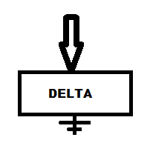
Singly Linked List Example
Delta is the first item in our list, so it is the head
There is no successor, so the link is the EOL (End of List) marker

Slide 7

Singly Linked List Example
Now we insert Beta into the list. The insertion algorithm is:
Check to see if we have a new head
If so, insert as new head
Otherwise, traverse until the insertion point is reached
and insert the new item

Slide 8
Singly Linked List Example
Beta is the new head of the list. To insert a new head:
Link the new head node to the old head node

Slide 9
Singly Linked List Example
Beta is the new head of the list. To insert a new head:
Link the new head node to the old head node

Slide 10
Singly Linked List Example
Beta is the new head of the list. To insert a new head:
Link the new head node to the old head node
Make the new node the new head

Slide 11


Singly Linked List Example
Beta is the new head of the list. To insert a new head:
Link the new head node to the old head node.
Make the new node the new head.

Slide 12
Singly Linked List Example
Beta is the new head of the list. To insert a new head:
Link the new head node to the old head node.
Make the new item the new head.
Now the traversal is BETA - DELTA

Slide 13
Singly Linked List Example
Now we insert a new node, Alpha.

Slide 14

Singly Linked List Example
Now we insert a new node, Alpha.

Slide 15
Singly Linked List Example
Now we insert a new node, Alpha.
Alpha is the new head.

Slide 16
Singly Linked List Example
Now we insert a new node, Alpha.
Alpha is the new head.
The new node gets a link to the previous head node…

Slide 17
Singly Linked List Example
Now we insert a new node, Alpha.
Alpha is the new head.
The new node gets a link to the previous head node…

Slide 18
Singly Linked List Example
Now we insert a new node, Alpha.
Alpha is the new head.
The new node gets a link to the previous head node…
…and the new node becomes the new head.

Slide 19


Singly Linked List Example
Now we insert a new node, Alpha.
Alpha is the new head.
The new node gets a link to the previous head node…
…and the new node becomes the new head.

Slide 20
Singly Linked List Example
Now we insert a new node, Alpha.
Alpha is the new head.
The new node gets a link to the previous head node…
…and the new node becomes the new head.
The traversal is now ALPHA – BETA - DELTA

Slide 21
Singly Linked List Example
Now we insert a new node, Gamma

Slide 22

Singly Linked List Example
Now we insert a new node, Gamma

Slide 23
Singly Linked List Example
Now we insert a new node, Gamma
Gamma is not the new head (it is alphabetically larger than Alpha)

Slide 24
Singly Linked List Example
Now we insert a new node, Gamma
Gamma is not the new head (it is alphabetically larger than Alpha)
So we traverse, but look one ahead of the current node.

Slide 25
Singly Linked List Example
Now we insert a new node, Gamma
Gamma is not the new head (it is alphabetically larger than Alpha)
So we traverse, but look one ahead of the current node.
From the head, we see that the head links to Beta.

Slide 26
Singly Linked List Example
Now we insert a new node, Gamma
Gamma is not the new head (it is alphabetically larger than Alpha)
So we traverse, but look one ahead of the current node.
From the head, we see that the head links to Beta.
Beta < Gamma, so we advance our traversal pointer to Alpha's pointer.

Slide 27
Singly Linked List Example
From Alpha's pointer, we see that Beta points to Delta

Slide 28
Singly Linked List Example
From Alpha's pointer, we see that Beta points to Delta
Delta < Gamma, so we advance to the next pointer

Slide 29
Singly Linked List Example
From Alpha's pointer, we see that Beta points to Delta
Delta < Gamma, so we advance to the next pointer
From Beta's pointer, we see that Delta points to End Of List.

Slide 30
Singly Linked List Example
From Alpha's pointer, we see that Beta points to Delta
Delta < Gamma, so we advance to the next pointer
From Beta's pointer, we see that Delta points to End Of List.
We have reached the insertion point – Gamma is the new "tail" of the list

Slide 31
Singly Linked List Example
The insertion algorithm is:

Slide 32
Singly Linked List Example
The insertion algorithm is:
Give the pointer at the indicated item to the new entry

Slide 33

Singly Linked List Example
The insertion algorithm is:
Give the pointer at the indicated item to the new entry

Slide 34
Singly Linked List Example
The insertion algorithm is:
Give the pointer at the indicated item to the new entry
Now point the indicated item to the new entry.

Slide 35
Singly Linked List Example
The insertion algorithm is:
Give the pointer at the indicated item to the new entry
Now point the indicated item to the new entry.

Slide 36
Singly Linked List Example
The insertion algorithm is:
Give the pointer at the indicated item to the new entry
Now point the indicated item to the new entry.
The traversal is now ALPHA – BETA – DELTA – GAMMA

Slide 37
Singly Linked List Example
Now we insert PI into the list.

Slide 38

Singly Linked List Example
Now we insert PI into the list.

Slide 39
Singly Linked List Example
Now we insert PI into the list.
PI is not a new head node, so we traverse until we reach the insertion point

Slide 40
Singly Linked List Example
From the head pointer we see Beta

Slide 41
Singly Linked List Example
From the head pointer we see Beta
Beta < Pi, so advance to the next pointer

Slide 42
Singly Linked List Example
From the Alpha pointer we see Delta

Slide 43
Singly Linked List Example
From the Alpha pointer we see Delta
Delta < Pi, so advance to the next pointer

Slide 44
Singly Linked List Example
Notice that we are always looking two ahead!

Slide 45
Singly Linked List Example
From the Beta pointer we see Gamma

Slide 46
Singly Linked List Example
From the Beta pointer we see Gamma
Gamma < Pi so advance to the next pointer

Slide 47
Singly Linked List Example
From the Delta pointer we see the End of List marker

Slide 48
Singly Linked List Example
From the Delta pointer we see the End of List marker
We have reached the insertion point

Slide 49
Singly Linked List Example
From the Delta pointer we see the End of List marker
We have reached the insertion point
The new entry gets Gamma's link…

Slide 50

Singly Linked List Example
From the Delta pointer we see the End of List marker
We have reached the insertion point
The new entry gets Gamma's link…

Slide 51
Singly Linked List Example
From the Delta pointer we see the End of List marker
We have reached the insertion point
…and Gamma links to the new node

Slide 52
Singly Linked List Example
From the Delta pointer we see the End of List marker
We have reached the insertion point
…and Gamma links to the new node

Slide 53
Singly Linked List Example
The traversal is ALPHA – BETA – DELTA – GAMMA - PI

Slide 54
Singly Linked List Example
The next node is LAMBDA

Slide 55

Singly Linked List Example
The next node is LAMBDA

Slide 56
Singly Linked List Example
The next node is LAMBDA
Lambda > Alpha so it's not the new head

Slide 57
Singly Linked List Example
The next node is LAMBDA
Lambda > Alpha so it's not the new head
We must traverse to find the insertion point

Slide 58
Singly Linked List Example
From the head link we see Beta

Slide 59
Singly Linked List Example
From the head link we see Beta
Beta < Lambda so we're not there yet – advance to the next pointer

Slide 60
Singly Linked List Example
From Alpha's link we see Delta

Slide 61
Singly Linked List Example
From Alpha's link we see Delta
Delta < Lambda so advance to the next link

Slide 62
Singly Linked List Example
From Beta's link we see Gamma

Slide 63
Singly Linked List Example
From Beta's link we see Gamma
Gamma < Lambda so advance to the next link

Slide 64
Singly Linked List Example
From Delta's link we see Pi

Slide 65
Singly Linked List Example
From Delta's link we see Pi
Pi > Lambda so we are now at the insertion point

Slide 66
Singly Linked List Example
From Delta's link we see Pi
Pi > Lambda so we are now at the insertion point
From Delta's link, we can copy Gamma's link to the new entry

Slide 67
Singly Linked List Example
From Delta's link we see Pi
Pi > Lambda so we are now at the insertion point
From Delta's link, we can copy Gamma's link to the new entry

Slide 68
Singly Linked List Example
From Delta's link we see Pi
Pi > Lambda so we are now at the insertion point
Now we set Gamma's link to the new entry

Slide 69
Singly Linked List Example
From Delta's link we see Pi
Pi > Lambda so we are now at the insertion point
Now we set Gamma's link to the new entry

Slide 70
Singly Linked List Example
The traversal is now ALPHA – BETA – DELTA – GAMMA – LAMBDA - PI

Slide 71
Singly Linked List Example
We now insert Epsilon into the list

Slide 72

Singly Linked List Example
We now insert Epsilon into the list

Slide 73
Singly Linked List Example
We now insert Epsilon into the list
We will re-write one link…

Slide 74

Singly Linked List Example
We now insert Epsilon into the list
That will help us out later

Slide 75
Singly Linked List Example
Epsilon > Alpha so the new entry is not a new head node

Slide 76
Singly Linked List Example
Epsilon > Alpha so the new entry is not a new head node
We must traverse until we reach the pointer just before the entry point

Slide 77
Singly Linked List Example
From the head pointer we can see Beta

Slide 78
Singly Linked List Example
From the head pointer we can see Beta
Beta < Epsilon, so advance to the next pointer

Slide 79
Singly Linked List Example
From the Alpha pointer we can see Delta

Slide 80
Singly Linked List Example
From the Alpha pointer we can see Delta
Delta < Epsilon, so advance to the next pointer

Slide 81
Singly Linked List Example
From the Beta pointer we can see Gamma

Slide 82
Singly Linked List Example
From the Beta pointer we can see Gamma
Gamma > Epsilon, so we are now at our insertion point

Slide 83
Singly Linked List Example
From the Beta pointer we can see Gamma
Gamma > Epsilon, so we are now at our insertion point
We do everything from Beta's pointer, which currently points to Delta

Slide 84
Singly Linked List Example
The new entry (Epsilon) gets a copy of Gamma's pointer

Slide 85
Singly Linked List Example
The new entry (Epsilon) gets a copy of Gamma's pointer

Slide 86
Singly Linked List Example
The new entry (Epsilon) gets a copy of Gamma's pointer
Now Gamma points to the new entry (Epsilon)

Slide 87
Singly Linked List Example
The new entry (Epsilon) gets a copy of Gamma's pointer
Now Gamma points to the new entry (Epsilon)

Slide 88
Singly Linked List Example
The traversal is now
ALPHA – BETA – DELTA – GAMMA – EPSILON – LAMBDA - PI

Slide 89
Singly Linked List Example
There are only two cases to consider for insertion

Slide 90
Singly Linked List Example
There are only two cases to consider for insertion
New head node

Slide 91
Singly Linked List Example
There are only two cases to consider for insertion
New head node
Mid and tail insert (same algorithm for both)

Slide 92
Singly Linked List Example
Now we will delete some entries

Slide 93
Singly Linked List Example
Now we will delete some entries
Again there are only two cases

Slide 94
Singly Linked List Example
Now we will delete some entries
Again there are only two cases
Delete the head node (and promote another node to head)

Slide 95
Singly Linked List Example
Now we will delete some entries
Again there are only two cases
Delete the head node (and promote another node to head)
Mid and tail delete (same algorithm for both)

Slide 96
Singly Linked List Example
We will start with a mid-list delete

Slide 97
Singly Linked List Example
We will start with a mid-list delete
We will delete Delta from the list

Slide 98
Singly Linked List Example
We will start with a mid-list delete
We will delete Delta from the list
We check to see if Delta is the head

Slide 99
Singly Linked List Example
We will start with a mid-list delete
We will delete Delta from the list
We check to see if Delta is the head
It is not, so we traverse…

Slide 100
Singly Linked List Example
From the head node we look ahead to see Beta

Slide 101
Singly Linked List Example
From the head node we look ahead to see Beta
Beta is less than the item to be deleted, so we move to the next pointer

Slide 102
Singly Linked List Example
From Alpha's pointer we look ahead to Delta

Slide 103
Singly Linked List Example
From Alpha's pointer we look ahead to Delta
We have found the item to be deleted

Slide 104
Singly Linked List Example
The algorithm is just copy the link from the item to be delete to the item to the current link

Slide 105
Singly Linked List Example
Since Delta is to be deleted, Beta gets a copy of Delta's pointer

Slide 106
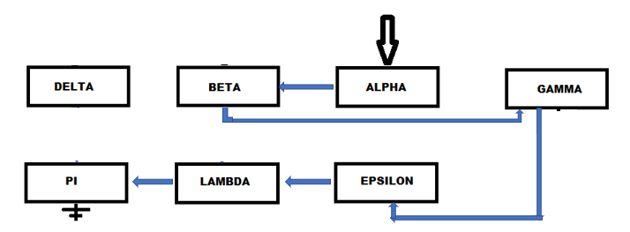
Singly Linked List Example
Since Delta is to be deleted, Beta gets a copy of Delta's pointer

Slide 107
Singly Linked List Example
Since Delta is to be deleted, Beta gets a copy of Delta's pointer
Now Delta has been cut out of the list

Slide 108
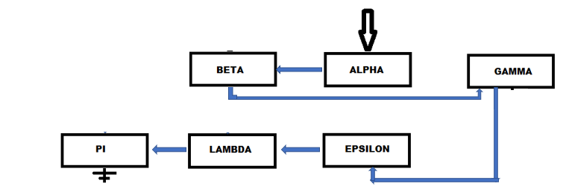
Singly Linked List Example
Since Delta is to be deleted, Beta gets a copy of Delta's pointer
Now Delta has been cut out of the list

Slide 109
Singly Linked List Example
Since Delta is to be deleted, Beta gets a copy of Delta's pointer
The traversal is
ALPHA – BETA – GAMMA – EPSILON – LAMBDA - PI

Slide 110
Singly Linked List Example
Let's delete Delta again

Slide 111
Singly Linked List Example
Let's delete Delta again
Delta > Alpha so it's not a head node delete, so we traverse

Slide 112
Singly Linked List Example
From the head pointer we see Beta

Slide 113
Singly Linked List Example
From the head pointer we see Beta
Beta < Delta so we're not there yet, advance to the next pointer

Slide 114
Singly Linked List Example
From Alpha's pointer we see Gamma

Slide 115
Singly Linked List Example
From Alpha's pointer we see Gamma
But Gamma > Delta!

Slide 116
Singly Linked List Example
From Alpha's pointer we see Gamma
But Gamma > Delta!
We have moved beyond the item we seek

Slide 117
Singly Linked List Example
From Alpha's pointer we see Gamma
But Gamma > Delta!
We have moved beyond the item we seek
The delete function returns false – delete failed, item not found

Slide 118
Singly Linked List Example
Now we will delete Alpha, the head node

Slide 119
Singly Linked List Example
Now we will delete Alpha, the head node
The next item in the list becomes the new head node

Slide 120

Singly Linked List Example
Now we will delete Alpha, the head node
The next item in the list becomes the new head node

Slide 121
Singly Linked List Example
Now we will delete Alpha, the head node
The next item in the list becomes the new head node
Alpha is now out of the list

Slide 122

Singly Linked List Example
Now we will delete Alpha, the head node
The next item in the list becomes the new head node
Alpha is now out of the list

Slide 123
Singly Linked List Example
The traversal is now
BETA – GAMMA – EPSILON – LAMBDA - PI

Slide 124
Singly-Linked List in C++
Now we want to code this in C++

Slide 125
Singly-Linked List in C++
Now we want to code this in C++
We begin with a "struct" to serve as our Linked List Node

Slide 126
Singly-Linked List in C++
Now we want to code this in C++
We begin with a "struct" to serve as our Linked List Node
That struct will contain a data element and a pointer to the next node

Slide 127
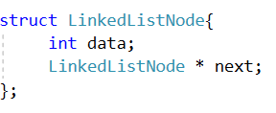
Singly-Linked List in C++
Now we want to code this in C++
We begin with a "struct" to serve as our Linked List Node
That struct will contain a data element and a pointer to the next node

Slide 128
Singly-Linked List in C++
Now we want to code this in C++
We begin with a "struct" to serve as our Linked List Node
That struct will contain a data element and a pointer to the next node
Note the trailing semicolon.

Slide 129
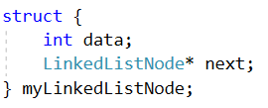
Why?
We are allowed to write this code in C++:
where we have created an anonymous struct with one instance,
named myLinkedListNode.

Slide 130
Why?
We are allowed to write this code in C++:
This is actually pretty common in systems programming, where you need only one instance of a struct.

Slide 131
Why?
We are allowed to write this code in C++:
So rather than give the struct a name, you just create the one instance you need (in this case, myLinkedListNode)

Slide 132
Why?
We are allowed to write this code in C++:
Because this is a possibility, the code for structs and classes in C++ must be terminated by a semicolon.

Slide 133
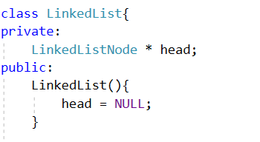
Singly-Linked List in C++
Now we start our LinkedList class.
The only data element is a LinkedListNode to serve as the head.
The only constructor will create an initially empty LinkedList.

Slide 134
Singly-Linked List in C++
We will have only three methods in our LinkedList class:

Slide 135
Singly-Linked List in C++
We will have only three methods in our LinkedList class:
Traverse

Slide 136
Singly-Linked List in C++
We will have only three methods in our LinkedList class:
Traverse
Insert

Slide 137
Singly-Linked List in C++
We will have only three methods in our LinkedList class:
Traverse
Insert
Remove

Slide 138
Singly-Linked List in C++
We will have only three methods in our LinkedList class:
Traverse
Insert
Remove
Remove will have return type bool, as it might fail on item not found.

Slide 139
Singly-Linked List in C++
We will have only three methods in our LinkedList class:
Traverse
Insert
Remove
Remove will have return type bool, as it might fail on item not found.
We don't anticipate that traverse or insert will fail, so they are void functions

Slide 140
Linked List - Traverse
For traversal, we take advantage of the fact that a null link is false.

Slide 141
Linked List - Traverse
For traversal, we take advantage of the fact that a null link is false.
We set our traversal pointer equal to the head.

Slide 142
Linked List - Traverse
For traversal, we take advantage of the fact that a null link is false.
We set our traversal pointer equal to the head.
Then, so long as the link we have is true, we visit that item and then advance to the next link.

Slide 143
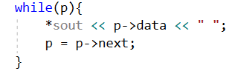
Linked List - Traverse
For traversal, we take advantage of the fact that a null link is false.
We set our traversal pointer equal to the head.
Then, so long as the link we have is true, we visit that item and then advance to the next link.

Slide 144
Linked List - Traverse
For traversal, we take advantage of the fact that a null link is false.
We set our traversal pointer equal to the head.
Then, so long as the link we have is true, we visit that item and then advance to the next link.
So what's with the arrows?

Slide 145
Classes, Structs, and Pointers
A struct is a way of aggregating several data elements.

Slide 146
Classes, Structs, and Pointers
A struct is a way of aggregating several data elements.
We use a struct for our LinkedListNode.

Slide 147
Classes, Structs, and Pointers
A struct is a way of aggregating several data elements.
We use a struct for our LinkedListNode.
The two elements are data and a pointer.

Slide 148
Classes, Structs, and Pointers
A struct is a way of aggregating several data elements.
We use a struct for our LinkedListNode.
The two elements are data and a pointer.
A class in C++ is, to some extent, just a struct with functions.

Slide 149
Classes, Structs, and Pointers
A struct is a way of aggregating several data elements.
We use a struct for our LinkedListNode.
The two elements are data and a pointer.
A class in C++ is, to some extent, just a struct with functions.
That's how object-oriented programming began in mainstream programming.

Slide 150
Classes, Structs, and Pointers
A struct is a way of aggregating several data elements.
We use a struct for our LinkedListNode.
The two elements are data and a pointer.
A class in C++ is, to some extent, just a struct with functions.
That's how object-oriented programming began in mainstream programming.
C structs gained functions, and were then called "classes."

Slide 151
Classes, Structs, and Pointers
To invoke a struct or class data element or function, use the dot operator.

Slide 152
Classes, Structs, and Pointers
To invoke a struct or class data element or function, use the dot operator.
MyClass x;
x.doThis();

Slide 153
Classes, Structs, and Pointers
To invoke a struct or class data element or function, use the dot operator.
MyClass x;
x.doThis();
This is typical of object-oriented languages.

Slide 154
Classes, Structs, and Pointers
To invoke a struct or class data element or function, use the dot operator.
MyClass x;
x.doThis();
This is typical of object-oriented languages.
Note that in C++ we say "class function" or "member function" not "method"

Slide 155
Classes, Structs, and Pointers
But what if you have a pointer to a class?

Slide 156
Classes, Structs, and Pointers
But what if you have a pointer to a class?
In C++ you can create objects in two different ways:

Slide 157
Classes, Structs, and Pointers
But what if you have a pointer to a class?
In C++ you can create objects in two different ways:
static objects

Slide 158
Classes, Structs, and Pointers
But what if you have a pointer to a class?
In C++ you can create objects in two different ways:
static objects
the "new" keyword is not used here

Slide 159
Classes, Structs, and Pointers
But what if you have a pointer to a class?
In C++ you can create objects in two different ways:
static objects
the "new" keyword is not used here
dynamic objects

Slide 160
Classes, Structs, and Pointers
But what if you have a pointer to a class?
In C++ you can create objects in two different ways:
static objects
the "new" keyword is not used here
dynamic objects
using "new" as in new object-oriented languages

Slide 161
Classes, Structs, and Pointers
But what if you have a pointer to a class?
In C++ you can create objects in two different ways:
static objects
the "new" keyword is not used here
dynamic objects
using "new" as in new object-oriented languages
new always returns a pointer!

Slide 162
Classes, Structs, and Pointers
This code creates a static or "stack" object.
MyClass x;
x.doThis();
x is on the stack and was created using the default constructor.

Slide 163
Classes, Structs, and Pointers
In this code, x is a pointer to the object.
MyClass * x = new MyClass();
x->doThis();
Here we have a dynamic object, instantiated at run time.

Slide 164
Classes, Structs, and Pointers
In this code, x is a pointer to the object.
MyClass * x = new MyClass();
x->doThis();
Here we have a dynamic object, instantiated at run time.
x is a pointer to that object, because new always returns a pointer.

Slide 165
Classes, Structs, and Pointers
In this code, x is a pointer to the object.
MyClass * x = new MyClass();
x->doThis();
Here we have a dynamic object, instantiated at run time.
x is a pointer to that object, because new always returns a pointer.
Note the -> arrow notation instead of a dot!

Slide 166
Classes, Structs, and Pointers
In most object-oriented languages, the only kind of objects you can have are dynamic, instantiated at run time, and accessed through a pointer.

Slide 167
Classes, Structs, and Pointers
In most object-oriented languages, the only kind of objects you can have are dynamic, instantiated at run time, and accessed through a pointer.
In those languages we always use the "dot" operator.

Slide 168
Classes, Structs, and Pointers
In most object-oriented languages, the only kind of objects you can have are dynamic, instantiated at run time, and accessed through a pointer.
In those languages we always use the "dot" operator.
In C++ there are two different ways to create objects.

Slide 169
Classes, Structs, and Pointers
In most object-oriented languages, the only kind of objects you can have are dynamic, instantiated at run time, and accessed through a pointer.
In those languages we always use the "dot" operator.
In C++ there are two different ways to create objects.
Therefore there are two different ways to access their data and behavior.

Slide 170
Classes, Structs, and Pointers
For C++ objects instantiated at compile time (not using new), we use dot.

Slide 171
Classes, Structs, and Pointers
For C++ objects instantiated at compile time (not using new), we use dot.
For C++ objects instantiated at run time (using new) we use arrow.

Slide 172
Classes, Structs, and Pointers
For C++ objects instantiated at compile time (not using new), we use dot.
For C++ objects instantiated at run time (using new) we use arrow.
In other words, if we have a pointer to the object in C++, use ->

Slide 173
Classes, Structs, and Pointers
For C++ objects instantiated at compile time (not using new), we use dot.
For C++ objects instantiated at run time (using new) we use arrow.
In other words, if we have a pointer to the object in C++, use ->
Yes, this is exactly backwards, but C structs came first (which use the dot operator to access elements), then C++ and dynamic objects, which required different notation.

Slide 174
Classes, Structs, and Pointers
For C++ objects instantiated at compile time (not using new), we use dot.
For C++ objects instantiated at run time (using new) we use arrow.
In other words, if we have a pointer to the object in C++, use ->
Newer languages kept only dynamic objects and used the simpler dot notation.

Slide 175
Linked List - Traversal
Let's look at that traversal code again…
What is this "sout" thing?

Slide 176
Linked List - Traversal
Let's look at that traversal code again…
What is this "sout" thing?
It will be convenient to direct our traversal output to whatever stream we choose (the console, a file, whatever).

Slide 177
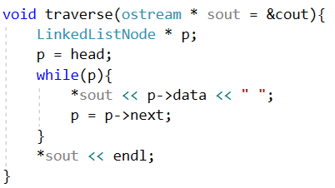
Linked List - Traversal

Slide 178
Linked List - Traversal
We send the traverse function a stream pointer, which defaults to cout.

Slide 179
Linked List - Traversal
We send the traverse function a stream pointer, which defaults to cout.
If we don't send a parameter, the traversal goes to the console.

Slide 180
Linked List - Traversal
We send the traverse function a stream pointer, which defaults to cout.
If we don't send a parameter, the traversal goes to the console.
If we do, the traversal goes to wherever we say.

Slide 181
Linked List - Traversal
We send the traverse function a stream pointer, which defaults to cout.
Note that since it's a pointer, we have to dereference it with *

Slide 182
Linked List - Insert
The first case that we have to test is – do we have an empty list?

Slide 183
Linked List - Insert
The first case that we have to test is – do we have an empty list?
If so, the item to be inserted becomes the head node (and only node).

Slide 184
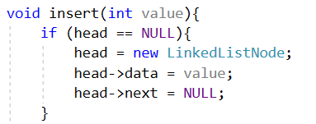
Linked List - Insert
The first case that we have to test is – do we have an empty list?
If so, the item to be inserted becomes the head node (and only node).

Slide 185
Linked List - Insert
The first case that we have to test is – do we have an empty list?
If so, the item to be inserted becomes the head node (and only node).
This node's link is NULL, indicating the end of the LinkedList.

Slide 186
Linked List in C++
You actually have enough now to write the beginning of the LinkedList class and a test program.

Slide 187
Linked List in C++
You actually have enough now to write the beginning of the LinkedList class and a test program.
You can only insert one item, and then traverse, but that's a start!

Slide 188
Linked List in C++
You actually have enough now to write the beginning of the LinkedList class and a test program.
You can only insert one item, and then traverse, but that's a start!
Try to write this code before continuing with this presentation.

Slide 189
Linked List in C++
You actually have enough now to write the beginning of the LinkedList class and a test program.
You can only insert one item, and then traverse, but that's a start!
Try to write this code before continuing with this presentation.
When you're writing code with pointers, it's important to do just a little at a time and test as you go.

Slide 190
Linked List - Insert
If the LinkedList is not empty, we first create a new LinkedListNode to contain the new entry. Then there are only two cases to consider:

Slide 191
Linked List - Insert
If the LinkedList is not empty, we first create a new LinkedListNode to contain the new entry. Then there are only two cases to consider:
New item is the new head

Slide 192
Linked List - Insert
If the LinkedList is not empty, we first create a new LinkedListNode to contain the new entry. Then there are only two cases to consider:
New item is the new head
New item is not the new head

Slide 193
Linked List – Insert New Head
To insert a new node as the new head:

Slide 194
Linked List – Insert New Head
To insert a new node as the new head:
Link the new item to the previous head

Slide 195
Linked List – Insert New Head
To insert a new node as the new head:
Link the new item to the previous head
Set the "head" pointer to the new item

Slide 196
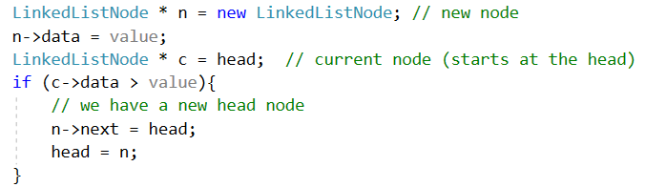
Linked List – Insert New Head

Slide 197
Linked List – Insert New Head
We create a new LinkedListNode, accessed through the pointer n,
and initialize the data field with the new item.
We also create a pointer to LinkedListNode and set it equal to the head.

Slide 198
Linked List – Insert New Head
n->next = head // links the new node to the previous head node
head = n // makes the new node the head node

Slide 199
Linked List – Insert New Head
DO NOT CONTINUE UNTIL YOU UNDERSTAND THIS CODE!

Slide 200
Linked List – Mid or Tail Insert
If the new item isn't the new head, it's a "mid or tail" insert.

Slide 201
Linked List – Mid or Tail Insert
If the new item isn't the new head, it's a "mid or tail" insert.
The algorithm is the same for both.

Slide 202
Linked List – Mid or Tail Insert
If the new item isn't the new head, it's a "mid or tail" insert.
The algorithm is the same for both.
Traverse until you reach the insertion point.

Slide 203
Linked List – Mid or Tail Insert
If the new item isn't the new head, it's a "mid or tail" insert.
The algorithm is the same for both.
Traverse until you reach the insertion point.
Remember, you are looking two data items ahead

Slide 204
Linked List – Mid or Tail Insert
If the new item isn't the new head, it's a "mid or tail" insert.
The algorithm is the same for both.
Traverse until you reach the insertion point.
Remember, you are looking two data items ahead
Once the insertion point is reached,

Slide 205
Linked List – Mid or Tail Insert
If the new item isn't the new head, it's a "mid or tail" insert.
The algorithm is the same for both.
Traverse until you reach the insertion point.
Remember, you are looking two data items ahead
Once the insertion point is reached,
The new node gets a copy of the next node's pointer

Slide 206
Linked List – Mid or Tail Insert
If the new item isn't the new head, it's a "mid or tail" insert.
The algorithm is the same for both.
Traverse until you reach the insertion point.
Remember, you are looking two data items ahead
Once the insertion point is reached,
The new node gets a copy of the next node's pointer
The next node points to the new node

Slide 207
Linked List – Mid or Tail Insert
If the new item isn't the new head, it's a "mid or tail" insert.
The algorithm is the same for both.
Traverse until you reach the insertion point.
Remember, you are looking two data items ahead
Once the insertion point is reached,
The new node gets a copy of the next node's pointer
The next node points to the new node
This works for both a "middle" item or the "tail" item.

Slide 208
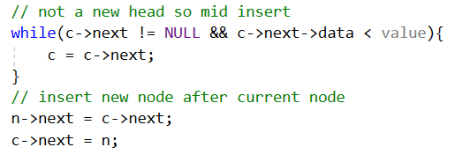
Linked List – Mid or Tail Insert
Pay careful attention to that traversal loop.

Slide 209
Linked List – Mid or Tail Insert
Pay careful attention to that traversal loop.
Note that we always check for NULL before following a pointer.

Slide 210
Linked List - Remove
There are two cases to consider for remove:

Slide 211
Linked List - Remove
There are two cases to consider for remove:
Item to be removed is the head

Slide 212
Linked List - Remove
There are two cases to consider for remove:
Item to be removed is the head
Item to be removed is not the head

Slide 213
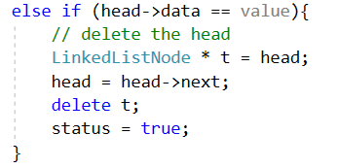
Linked List – Head Remove
To remove the head, just set the "head' pointer to the next item.

Slide 214
Linked List – Head Remove
To remove the head, just set the "head' pointer to the next item.
Delete returns a bool to indicate success or failure; that's the "status."

Slide 215
Linked List – Head Remove
To remove the head, just set the "head' pointer to the next item.
But what's the point of "t" and "delete t" ???

Slide 216
Memory Management in C++
Memory management in C++ is not automatic, as in other languages.

Slide 217
Memory Management in C++
Memory management in C++ is not automatic, as in other languages.
Advantage: it's faster and the programmer has complete control.

Slide 218
Memory Management in C++
Memory management in C++ is not automatic, as in other languages.
Advantage: it's faster and the programmer has complete control.
Disadvantage: do it correctly or you'll have memory leaks, or worse.

Slide 219
Memory Management in C++
Memory management in C++ is not automatic, as in other languages.
Advantage: it's faster and the programmer has complete control.
Disadvantage: do it correctly or you'll have memory leaks, or worse.
Any data item in a C++ program that is instantiated with "new"
must have a corresponding "delete."

Slide 220
Memory Management in C++
Memory management in C++ is not automatic, as in other languages.
Advantage: it's faster and the programmer has complete control.
Disadvantage: do it correctly or you'll have memory leaks, or worse.
Any data item in a C++ program that is instantiated with "new"
must have a corresponding "delete."
And that is why our function is called "remove" rather than delete.

Slide 221
Linked List – Remove
Simply cutting the item out of our Linked List isn't enough.

Slide 222
Linked List – Remove
Simply cutting the item out of our Linked List isn't enough.
Since those LinkedListNodes entered our program with "new,"
they must be discarded with "delete."

Slide 223
Linked List – Remove
Simply cutting the item out of our Linked List isn't enough.
Since those LinkedListNodes entered our program with "new,"
they must be discarded with "delete."
So we create a link to the node to be removed,

Slide 224
Linked List – Remove
Simply cutting the item out of our Linked List isn't enough.
Since those LinkedListNodes entered our program with "new,"
they must be discarded with "delete."
So we create a link to the node to be removed,
remove the item from our LinkedList (by copying links),

Slide 225
Linked List – Remove
Simply cutting the item out of our Linked List isn't enough.
Since those LinkedListNodes entered our program with "new,"
they must be discarded with "delete."
So we create a link to the node to be removed,
remove the item from our LinkedList (by copying links),
and then "delete" the memory allocated for that LinkedListNode.

Slide 226
Linked List – Remove
t (for temp) is a pointer to the LinkedListNode that we are removing.

Slide 227
Linked List – Remove
t (for temp) is a pointer to the LinkedListNode that we are removing.
→
Make a copy of the head pointer (that's t)

Slide 228
Linked List – Remove
t (for temp) is a pointer to the LinkedListNode that we are removing.
→
Over-write the head pointer with a pointer to the new head

Slide 229
Linked List – Remove
t (for temp) is a pointer to the LinkedListNode that we are removing.
→
Use the pointer t (which points to the now-removed previous head) to return the memory allocated for the old head to the heap manager.

Slide 230
Linked List – Remove
You've seen this before!

Slide 231
Linked List – Remove
You've seen this before!
Remember the array demo code at the beginning of the semester?

Slide 232
Linked List – Remove
You've seen this before!
Remember the array demo code at the beginning of the semester?
We kept re-using the same array name over and over, allocating memory over and over in an infinite loop…

Slide 233
Linked List – Remove
You've seen this before!
Remember the array demo code at the beginning of the semester?
We kept re-using the same array name over and over, allocating memory over and over in an infinite loop…
Failure to include the "delete" line and our program crashed.

Slide 234
Linked List – Remove
You've seen this before!
Remember the array demo code at the beginning of the semester?
We kept re-using the same array name over and over, allocating memory over and over in an infinite loop…
Failure to include the "delete" line and our program crashed.
Return previously allocated memory as required and it ran just fine.

Slide 235
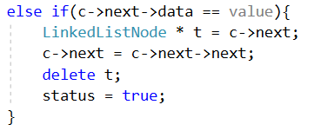
Linked List – Mid and Tail Remove
For mid and tail remove, we traverse until we reach the pointer to the LinkedListNode just ahead of the item to be remove, then shift links (to remove the item from our LinkedList) and "delete" the memory associated with that node (to keep the memory manager happy).

Slide 236
Linked List – Remove
We also have to worry about "item not found" so there is a fair amount of code to check for that and set the "status" variable.
Examine the full "remove" function code to see the full solution.

Slide 237
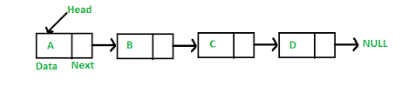
Linked List
The Linked List demo code is on Moodle for your programming pleasure.
You will modify it a bit to satisfy some homework and quiz requirements.
Have fun!

